Slide 1

BANGALORE INSTITUTE OF TECHNOLOGY
K.R Road, V.V Pura, Bengaluru-04
DEPARTMENT OF ARTIFICIAL INTELLIGENCE & MACHINE LEARNING
INTERNSHIP
“Web Development Intern, Prola Tech”
Presented by
USN - 1BI20AI024
Name – Kushal S Gowda
VIII Semester
Under the Guidance of
Prof. Yamini Sahukar P

Slide 2
Agenda
Introduction
Objectives
About Company / Organization
Tasks Assigned & Performed
Tools / Technologies Used
Skills Acquired
Architecture
Algorithm / Implementation Details
Results
Applications
Conclusion (With Reflection Outcomes - Communication Skills, Team Work, Time Management etc.)

Slide 3
Introduction
Expertise: Our team consists of skilled web developers proficient in the latest web technologies, frameworks, and ensuring high-quality and efficient implementations.
Critical Role: We prioritize user experience, creating intuitive and visually appealing websites that meet the needs of end-users, ensuring optimal engagement and satisfaction.
Innovation: Continuous exploring cutting-edge technologies and design trends, we strive to deliver innovative and engaging web solutions
Client-Centric: Our websites are optimized for seamless performance across various devices and browsers.
Continuous Improvement: Committed to excellence, we regularly refine our processes to align with evolving business objectives and technological advancements.

Slide 4
Objectives
Secure Development: Implement robust security measures and best practices throughout the development lifecycle to protect websites.
Performance Optimization: Ensure optimal website performance by implementing techniques such as code optimization, caching, and efficient resource handling.
Accessibility Compliance: Adhere to web accessibility guidelines and standards, ensuring that websites and applications are usable by individuals with disabilities
Disaster Recovery Preparedness: Develop and maintain disaster recovery plans for swift data recovery in case of emergencies.
Continuous Improvement: Continuously improve backup and storage processes to adapt to changing business needs.

Slide 5
About Company
Prola Tech is an IT services and product-based company offering a broad spectrum of services, including Mobile Application Development, Internet of Things (IoT) Web Services and Cloud Based Services.
Prola Tech provides end-to-end services from planning, developing, implementing, and managing. It helps businesses perform in an efficient, faster, and profitable manner.
They also develop products with cutting edge technologies in various verticals such as education.
They collaborate with a network of engineers, technical consultants, and subject matter experts to deliver services on par with CMMI standards.

Slide 6
Tasks Assigned & Performed
1. Coding and Development:
Task Assigned: assigned to work on front-end development tasks, such as creating new user interface components using HTML, CSS, and JavaScript.
Task Performed: Successfully create user interface components using HTML, CSS, and JavaScript.
2. Collaboration and Communication:
Task Assigned:attend team meetings, stand-ups, or project planning sessions. This allows them to understand the project's goals, progress
Task Performed: Attended team meeting and project planning sessions

Slide 7
Tasks Assigned
Title : “LearnTestPro”
Problem statement:
“Developing a distance learning application to offer students practice tests and track progress efficiently, addressing the growing need for remote education solutions.”

Slide 8
Tasks Assigned & Performed
Module
User Management Module
Test Management Module
Result and Analytics Module
Corporate Testing Module

Slide 9
Tools / Technologies Used
Text Editors/IDEs: Visual Studio Code.
Frontend Technologies: HTML, Css, Java Script.
Frontend Frameworks/Libraries: React.js for building interactive user interfaces.
Bootstrap for responsive design and styling.

Slide 10
Skills Acquired
HTML, CSS, and JavaScript: Fundamental languages for building web pages and adding interactivity.
Frontend Frameworks: Familiarity with libraries like React, Angular for efficient frontend development.
Responsive Design: Ability to create websites that work well on different devices and screen sizes.
Version Control/Git: Essential for tracking changes in code and collaborating with others.

Slide 11
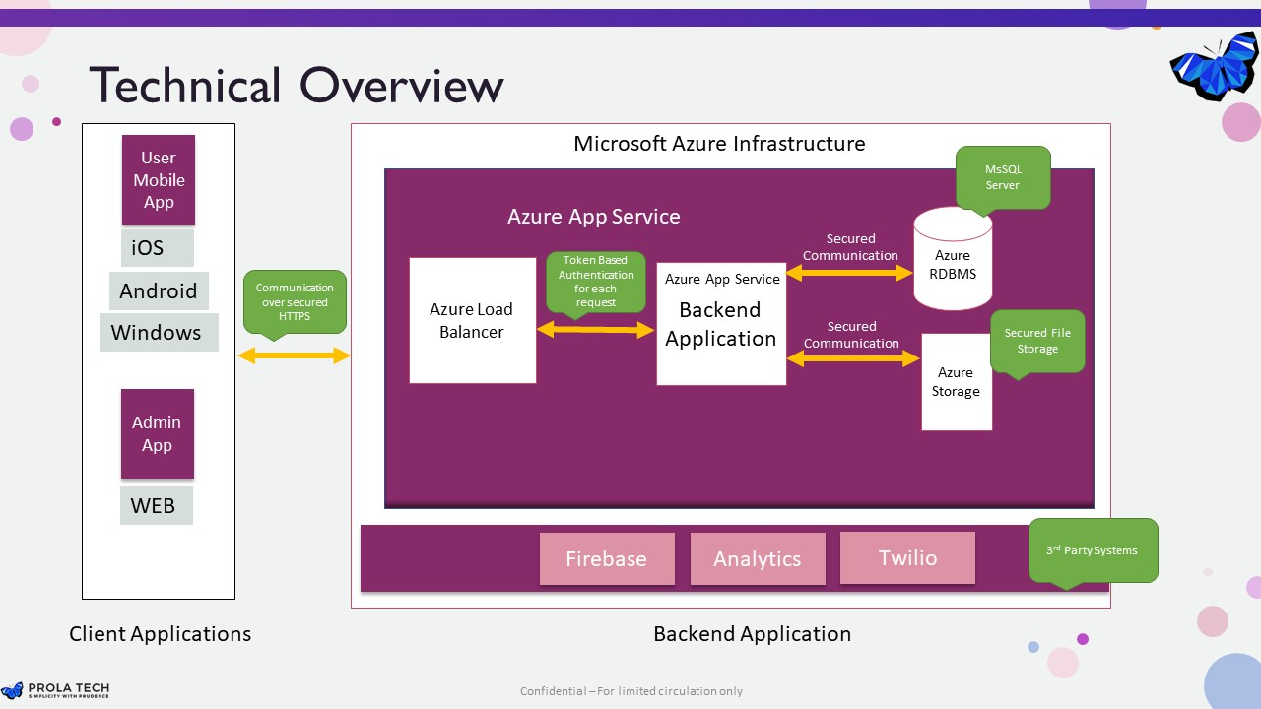
Architecture

Slide 12
Implementation Details
1. Microsoft Azure
Use Azure Blob Storage to host static websites or single-page applications (SPAs) directly from Azure Storage accounts. Launch virtual machines (VMs) in Azure to run your web application, either with a traditional server-side architecture or as part of a serverless setup using Azure App Service. Utilize Azure DevOps for automated deployment to Azure App Service or Azure VMs. Integrate Git with Azure DevOps pipelines to manage source code and trigger pipeline executions upon code changes. Define stages and tasks within the Azure DevOps pipeline to orchestrate the build, test, and deployment processes seamlessly.

Slide 13
Results
Create websites that adapt to different screen sizes using HTML, CSS (including frameworks like Bootstrap), and media queries.
Develop interactive user interfaces with JavaScript (including libraries like React, Vue.js) for dynamic content and user interactions.
Learn Git for version control, collaboration, and managing code repositories on platforms like GitHub or GitLab.

Slide 14
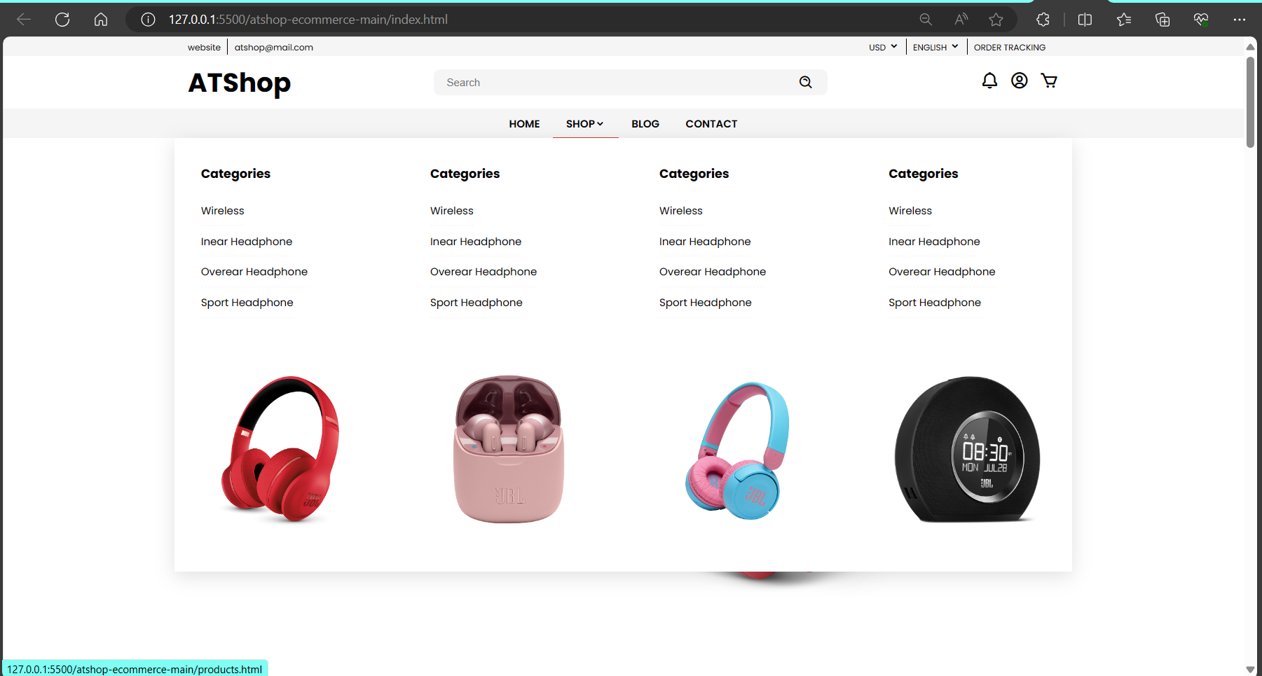
Results

Slide 15
Applications
Live Test Sessions: Conduct live test sessions where students can participate in real-time quizzes or exams with proctoring.
Live Tutoring Sessions: Offer live tutoring sessions where students can connect with tutors or instructors in real-time .
Instant Feedback: Offer instant feedback on answers submitted by students. Display correct answers, explanations, and suggestions for improvement .
Performance Analytics: Provide detailed analytics and insights to both students and educators.

Slide 16
Conclusion
During my internship, I learned how to solve problems and work well with others. I'm grateful for the help I received from the experienced people at the company. It made me more confident and helped me see things from different angles. This internship has been a big step forward for me, and I'm excited to use what I've learned in future projects.

Slide 17
Reflection Outcomes:
Communication Skills: Effective communication facilitated alignment and issue resolution.
Team Work: Collaborative effort among team members achieved objectives efficiently.
Time Management: Prioritization of tasks and regular progress assessments ensured timely completion.

